Slide 1
It’s TIME for a HERO
By House of Frazer

Slide 2
Team Members
Michael – Factory Level Designer, AI Programmer
Rhys – Ice Level Designer, Graphics Programming
Frazer – Village Level Designer, Story and Lore
Joshua – Hub Designer, UI Programmer, Sound Engineer
Faiz – Rigging, Modelling and Animation, NPC Programmer
Umayr – Player Programming

Slide 3
Game Overview

Slide 4
Genres
Action - Combat mechanics using various ranged spells and melee attack
Fantasy – Designed to look fantasy like trying to keep with the theme as much as possible
Puzzle – levels are designed using puzzles making the player complete them using the time travel mechanic to access new areas

Slide 5
Core Mechanics
Time Travel
Basic Melee and Ranged Attack
Shop System (Health, Mana, Spells, Damage)
Pickups (Money, HP potions, Mana potions)
Enemy/Friendly AI (Time Wizard, Shop Keeper)

Slide 6
Current Progress

Slide 7
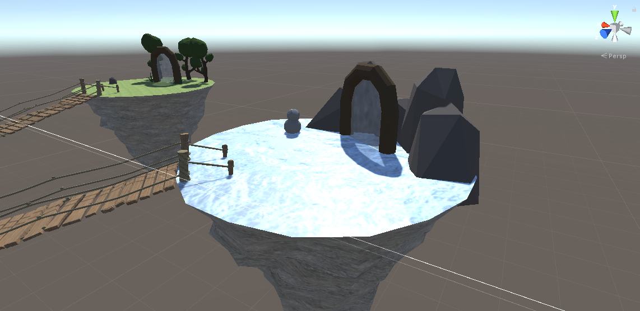
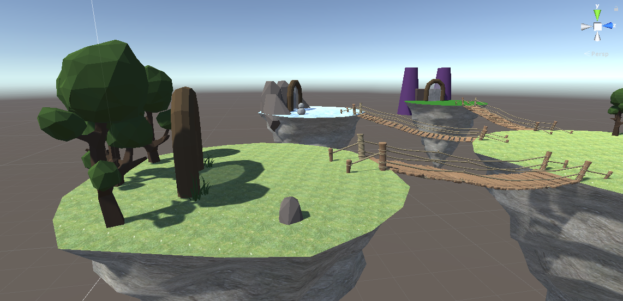
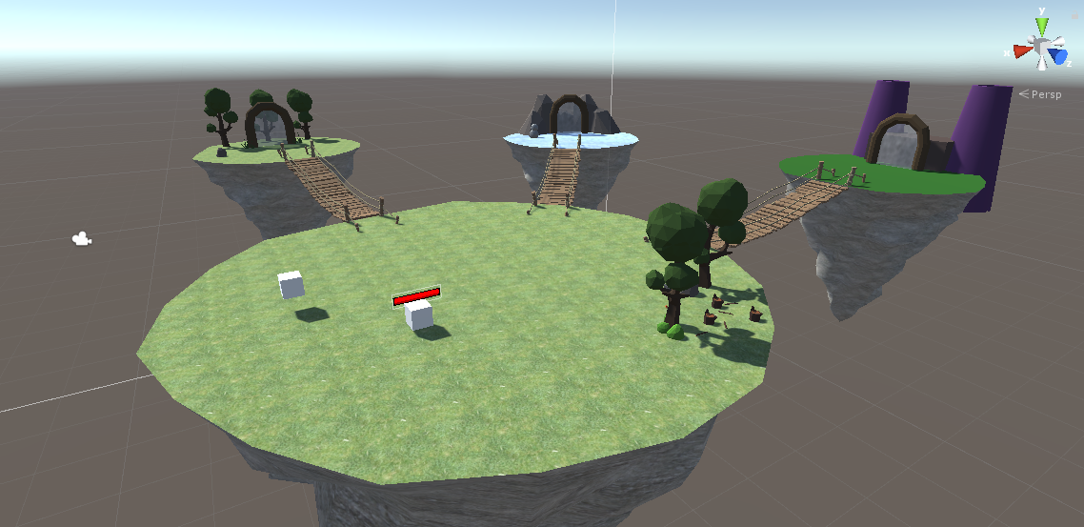
Hub
Split into four different sky islands
Three smaller islands have a portal to each level
Each island is designed after the level it leads to

Slide 8
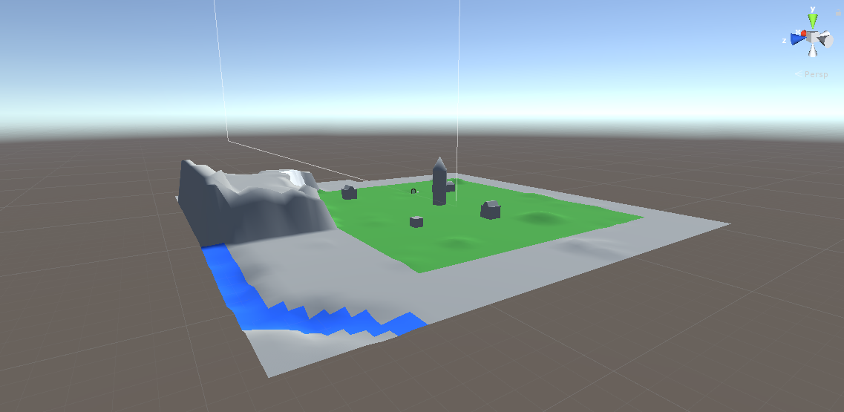
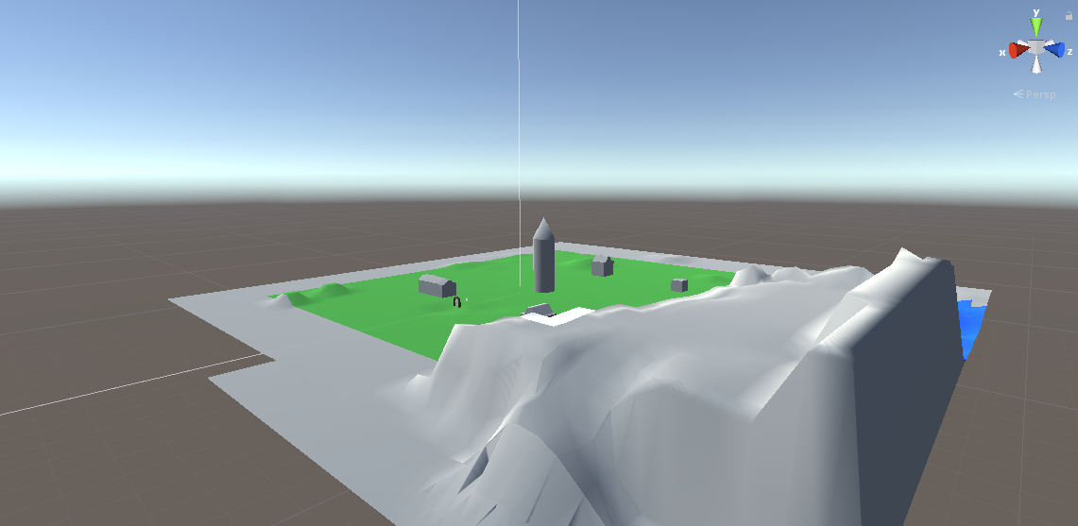
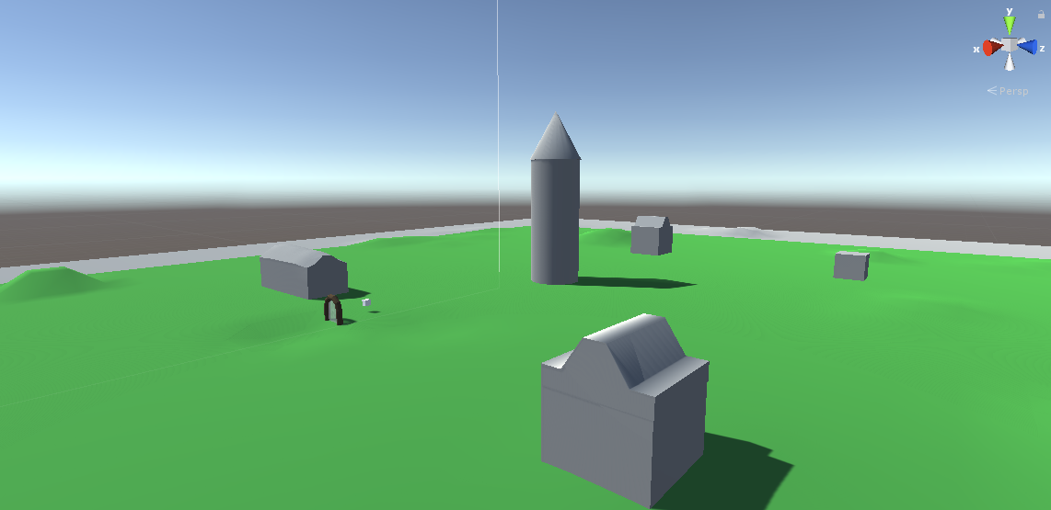
Wooded Village
Travel back in time to where the village is still in construction
Use a blueprint to change the locations of buildings
Plants are overgrown limiting movability in the future

Slide 9
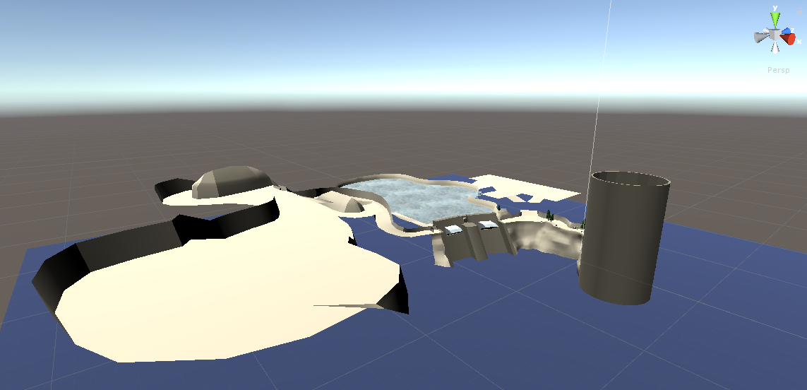
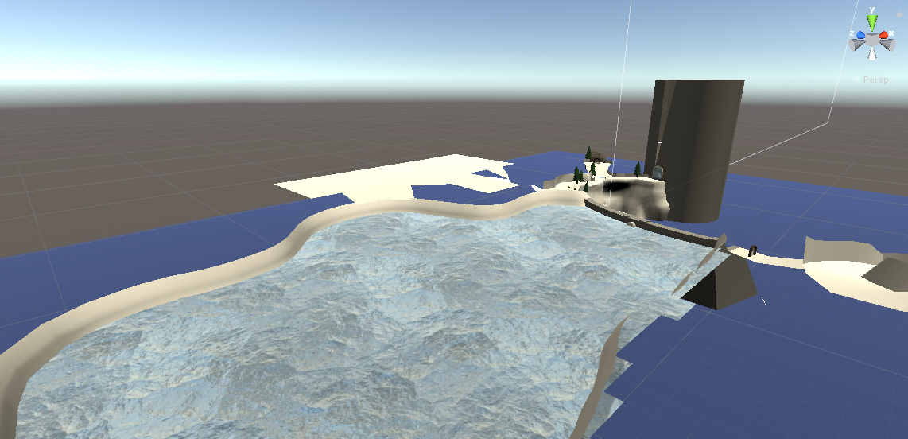
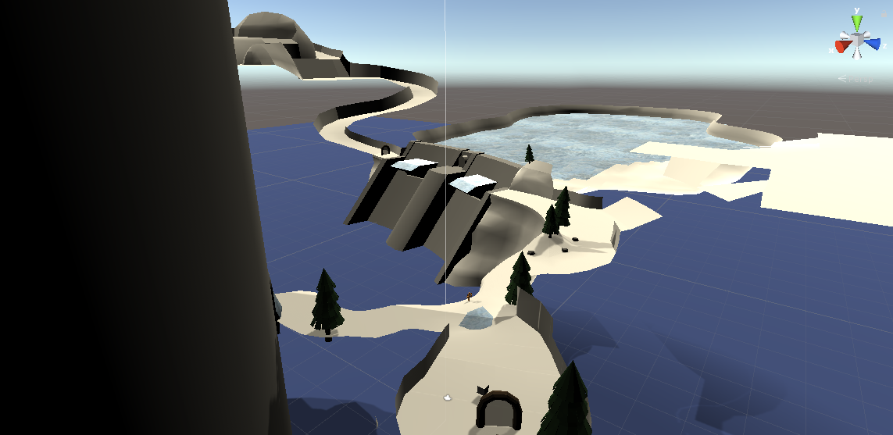
Ice World
Open water valves to change the flow of water
Travel in time to when the water wasn’t frozen
Changing water flow creates new platforms in the future
Impassable ice walls in the future

Slide 10
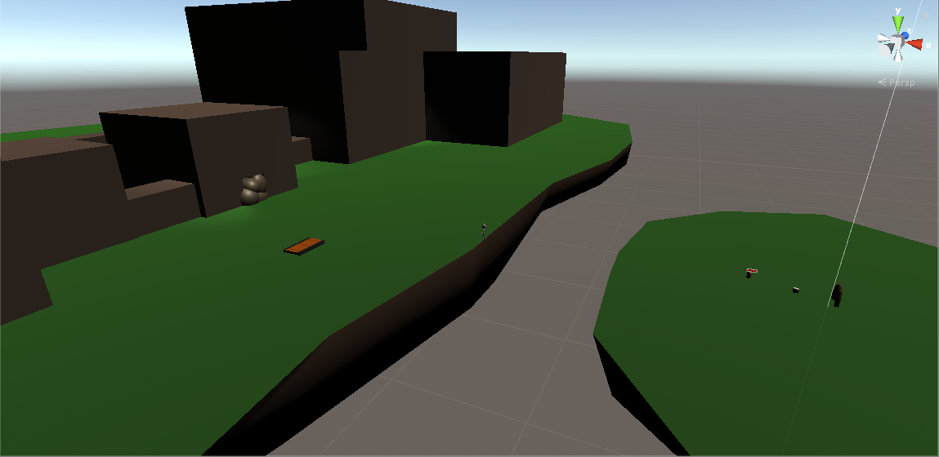
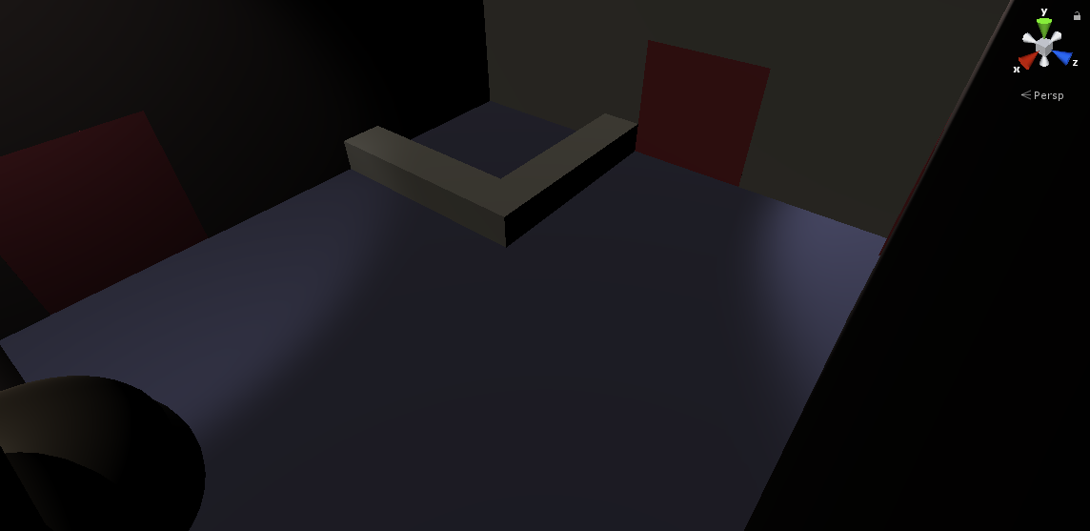
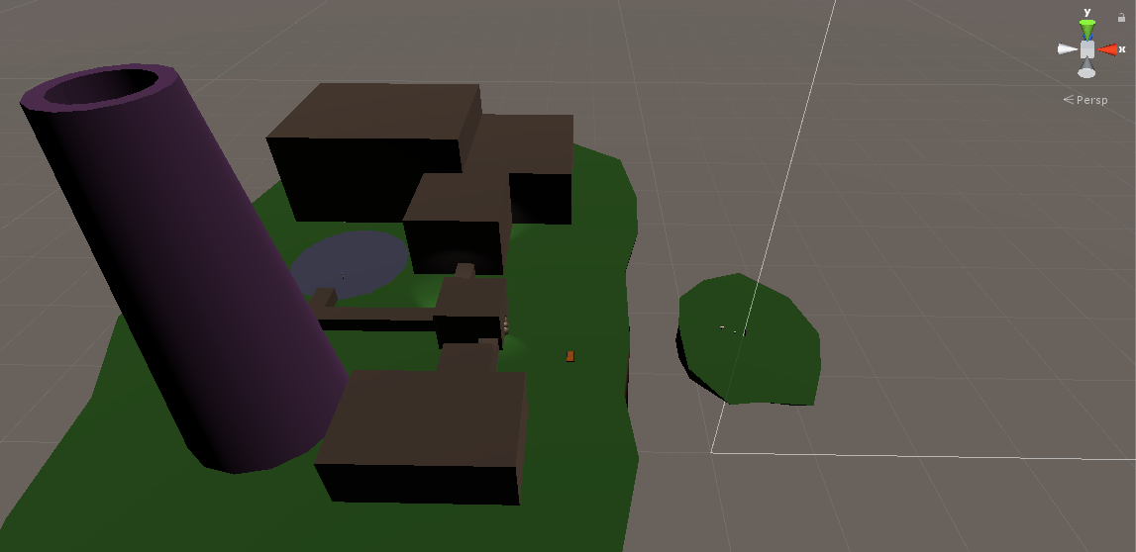
Haunted Factory
Fix machines in order to make the factory work again
Talk and do tasks for ghosts around the factory
Time travel to retrieve parts and help the ghosts pass over

Slide 11
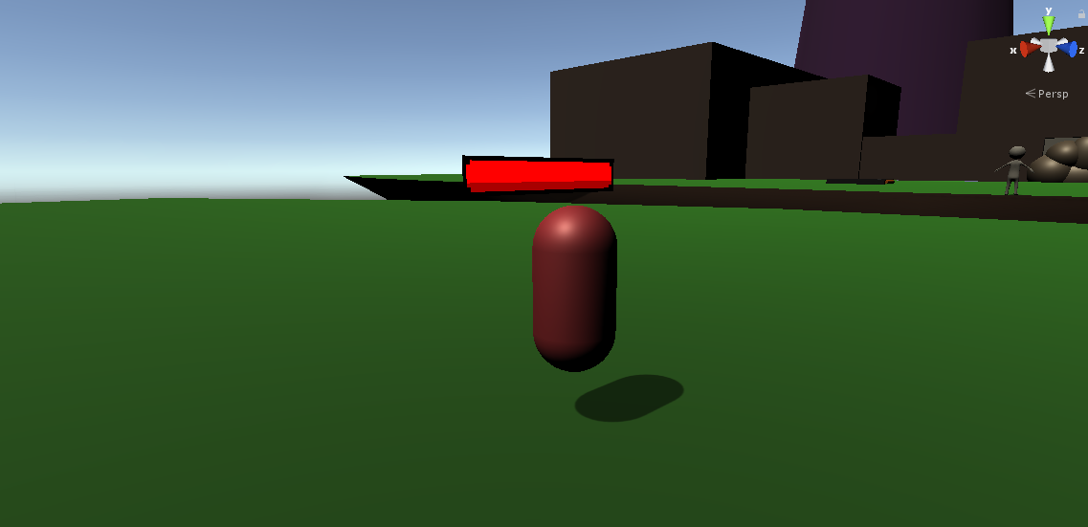
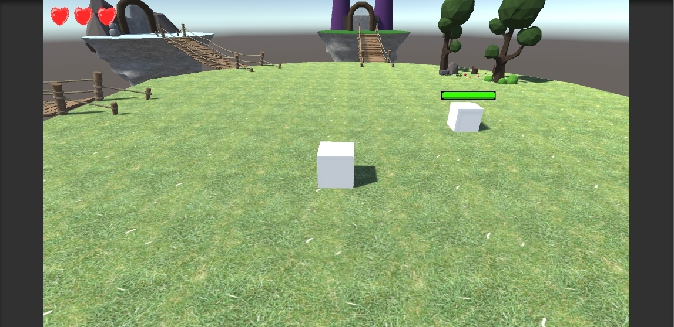
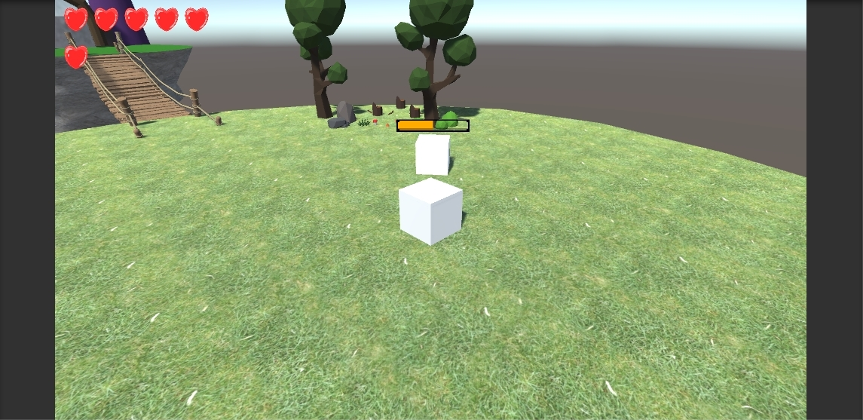
Player and Enemies
Player has basic movement for PC and Console
Basic Attack
Health System
Time Travel
Access to a shop system
Simple enemy with visual health bar
Factory enemy that splits apart

Slide 12
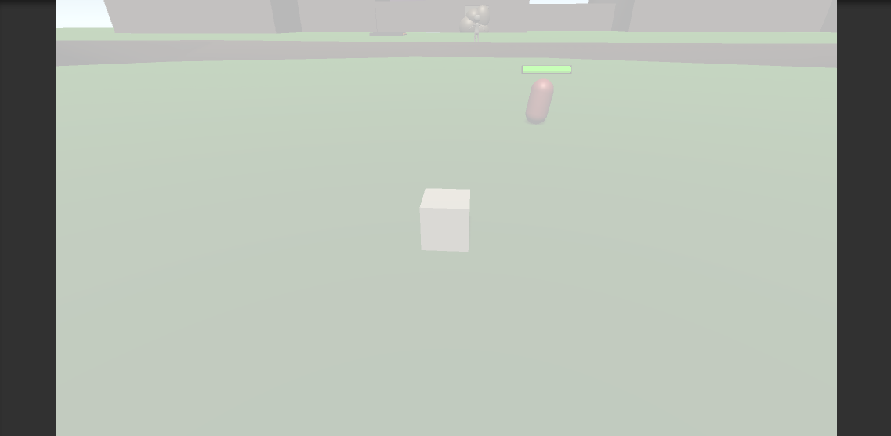
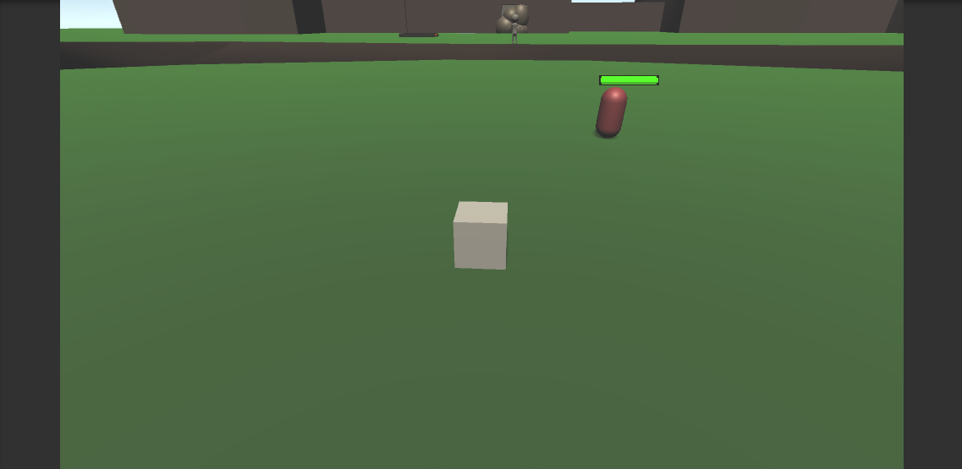

Time Travel
Player can travel back in time between a past and future version of levels
Opens up areas, complete puzzles, collect items
Fades to white and backout as levels are switched

Slide 13
Future Progress

Slide 14
Short Term
Add more to the UI and player such as Mana and on screen collectables
Tidy up the look of the levels
Add the basic ranged attacks for the player
Tidy up the levels main mechanics

Slide 15
Long Term
Add the rest of the puzzles and other content to the levels
Setup data persistence to the levels
Incorporate user options such as save/loading, volume setting, resolution
Add a title screen for the game
Add the players advanced elemental attacks
Add more AI/Enemies to the game

Slide 16
Thanks for Listening

